Slide 1

DIFF Product Analytic S18

Slide 2





Product establishment based on the Target Audience preferences
Diff Product Instruments S18
Target Audience
Customer Feedback Types
Our the main customers segments
Call customers when they bought tour | Satisfaction with the managers service quality | Working with the client who bought the tour, we learn what influenced the purchase of the hotel with the concept
CSQ | Satisfaction with service on vacation | 10 CSQ per day (in hotels) CSQ after vacation
NPS | Loyalty to the Brand/ Hotel | …
Check List | The level of conformity of the hotel concept, control of the elements | 1 time per week
Sociological surveys | Trends in the market, demanded products | On request
Families
Youth
Single
Couples
Friends

Slide 3
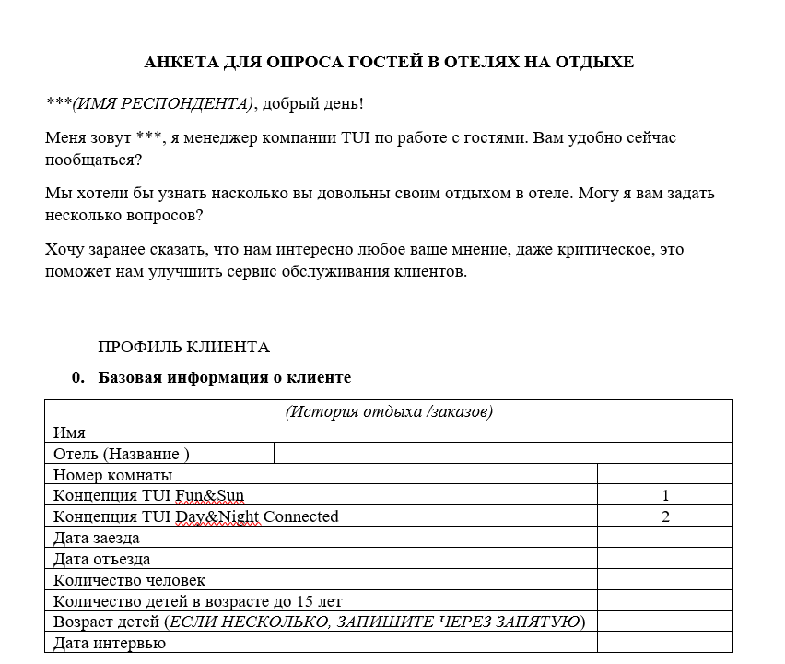
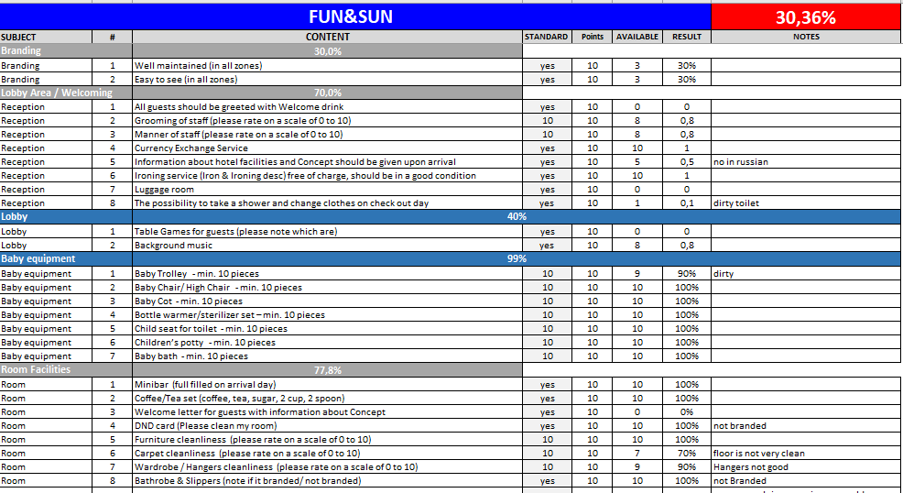

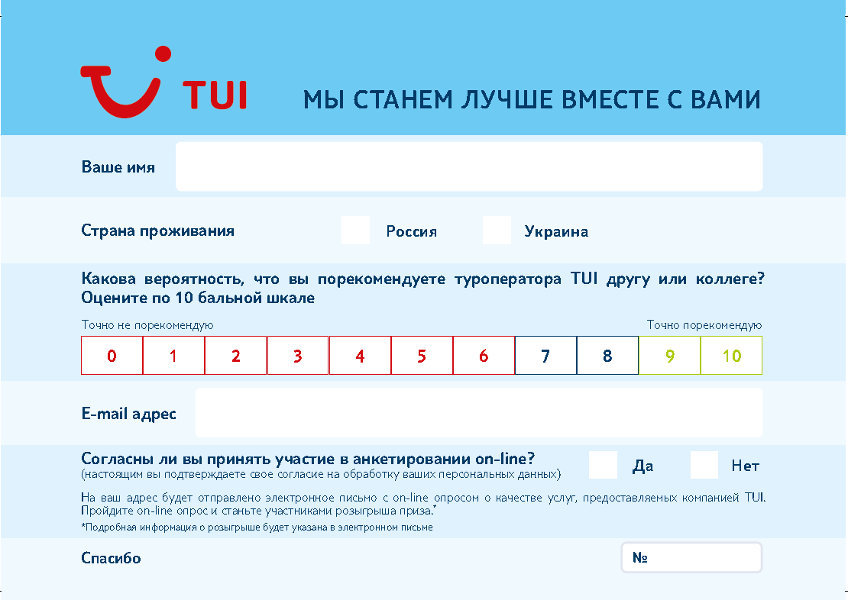
Analytical Instruments S18
Examples
Hotel Check List
Hotel CSQ
NPS опрос

Slide 4



Clients’ touchpoints to improve the product & concept
Before vacation
Awareness of the concept
In the Hotel
Services
After Vacation
Satisfaction / Loyalty
The main goal:
All hotels with concepts are sold with informing tourists where they are going, voicing the differences and key advantages of the hotel with the concept.
The main goal:
The quality of services in the hotel corresponds to the concept. Rating of master classes and all other activities.
The main goal:
Improving the product to customer request.
Increase LTV * of clients. Sale of an additional services taking into account knowledge about client preferences.
Verification and control of the correctness of the products sold
Asking for information from the client about expectations on vacation
Collection of client’ interests and preferences
Checking and controlling all the necessary services in the hotel
Request for rating of popular services in the hotel
Quality control of services and product
Collect information on recommendations and suggestions
Checking and monitoring customer satisfaction with vacation
Rating of services, identification of key
Collecting an information on recommendations and suggestions
Collection of information on the client's interests for the sale of additional services
* LTV – Lifetime Value

Slide 5

Questionnaire data before vacation
Phase «Tour buying»
What would you like to get from these vacations?
Conclusions:
The time we closed the list of answers instead of coding.
The results for Day&Night Connected are based on 4 respondents only, so they are indicated just for information as the statistical error may be quite high for this subgroup.
Most popular motive to spend vacations for TUI clients are ‘sun and sea’ and ‘rest from work and home duties’.
62% of F&S buyers are initially looking for entertainment for children.
With more interviews for D&N Connected buyers we will get more information about the difference between the two types of the clients.
* Number of respondents – 46 PAX (42 for Fun & Sun, 4 for Day & Night Connected )

Slide 6
Questionnaire data before vacation
Phase «Tour buying»
The initial factors of the customer' choice who bought the TUI FUN&SUN concept
Conclusions:
This time we added several factors which were mentioned as ‘Other’ before, but the sample done with this methodology is rather small at the moment (42 PAX), so the results can be used just as preliminary information.
Still most of those who bought the tour with Fun & Sun concept say that they were looking for a tour that would suit their situation (vacations with children). Now we also added ‘Children animation’ parameter and it also obtained very high score for importance.
Also important are infrastructure, quality of the beach and food (the same as it was in June and July).
Least important things for TUI Fun&Sun guests are still excursions and sport activities. We have split them into three different options and can see that the least important type of sport activity is a training room, while group trainings are scored much better.
Number of respondents – 310 PAX
for the factors marked as ‘NEW’ – 42 PAX

Slide 7
Questionnaire data before vacation
Phase «Tour buying»
The initial factors of the customer' choice who bought the TUI DAY&NIGHT CONNECTED concept
Conclusions:
Obviously, the most important things for this group are the quality of food, the infrastructure and the beach, same as for F&S customers.
Since the new factors were added, we can see now high scores for Good references and Wellness opportunities, but the sample size is still very small for them, so we will be able to evaluate their real importance later.
The fact that the hotel is suitable for youth is still a minor moment for those who buy D&N Connected tours, and its importance is not growing.
Such interests as excursion program and opportunities to practice certain sports are still among the outsiders. However their level of importance is higher than in the group of those who preferred Fun & Sun concept.
Number of respondents – 81 PAX
for the factors marked as ‘NEW’ – 4 PAX

Slide 8
Questionnaire data before vacation
Phase «Tour buying»
“How important was this for you?” (% of all respondents - even those who did not know about the concept)
“Did you know that you chose a tour with a concept?”, %
NO
YES
Conclusions:
Concepts awareness level is still rather high.
17% do not yet know about the concepts. In July their number slightly increased – from 14% to 19%, and now again decreased to 17% which can be explained with a smaller share of respondents, who chose Day&Night Connected concept.
In general, for most customers it still seems important to buy tour with concept, although there is a group of those who chose just a certain hotel or a certain service, and the concept was perceived as just additional feature.
* Number of respondents – 86 PAX (interviewed in August)

Slide 9
Questionnaire data in the hotel - NPS
Phase «Hotel»
17%
TUI FUN&SUN River Resort Belek 5*
87%
TUI FUN&SUN Club Belek 5*
Conclusions:
If we compare the results for June-July and August, we can see that except the hotels which had a small sample at the first stage (gray-colored) and Club Belek, the NPS figures are rather stable, with minor improving (NPS for Club Life Belek, Panthea Waterpark and Club Hydros is got slightly higher).
NPS for Club Belek has improved from 54% to 87%, making it the leader of the current rating. Nevertheless, it can be explained by either major improvement (which can hardly be imagined) or by violation of the methodology of interviewing (prompting for specific answers, choosing non-random guests etc). We also can see this high loyalty level in the questions on different services, so survey methodology in this hotel needs audit to make sure these results are correct.
* Number of respondents – 1640 PAX

Slide 10
TUI FUN&SUN Club Serra Palace

Slide 11
Questionnaire data in TUI FUN&SUN Club Serra Palace 5*
Phase «Hotel»
Level of services using. Rooms and Food & Beverage
Rating**
2,2
Conclusions:
4,8
Wi-Fi requires major improvements - it’s quality here is the worst among all the 8 hotels. And it is the most frequent complaint in the open-ended question about possible improvements in this hotel.
“Tea & Coffee set in the rooms” is not provided to all the guests – 60% do not even know about it and its score is rather low (perhaps it is not provided regularly or there is some other reason to define).
Bathrobe and slippers are also not provided to all the guests.
A la carte restaurants have low popularity, which is quite normal, but Fish restaurant has lower score than the other two.
Recommendations:
Improve the quality of Wi-Fi!
Check the situation with tea& coffee and bathrobe & slippers in the rooms.
Check the menu and service at the fish a la carte restaurant.
4,6
4,3
4,7
4,8
4,8
4,4
4,2
4,8
4,7
4,2
4,5
4,0
-
4,5
* Number of respondents – 161 PAX
** Evaluation of services on a 5-point scale

Slide 12
Questionnaire data in TUI FUN&SUN Club Serra Palace 5*
Phase «Hotel»
Level of services using. Entertainment.
Rating**
4,8
4,8
4,6
4,7
Conclusions:
All the Master classes are being evaluated, though have low attendance with low awareness.
All the scores for entertainment activities are rather high.
Recommendations:
Improve notification about the master classes and other activities.
4,6
5,0
5,0
5,0
5,0
5,0
5,0
5,0
* Number of respondents – 161 PAX1
** Evaluation of services on a 5-point scale

Slide 13
Questionnaire data in TUI FUN&SUN Club Serra Palace 5*
Phase «Hotel»
Level of services using. Entertainment & Sport
Rating**
4,9
4,0
4,8
3,9
5,0
4,9
Conclusions:
All the sports activities are not very popular except the group games (bocce, beach volleyball).
Some guests don’t know about the Pool Game, Club Dance, Olympic Games and Coffe Game.
SPA center services are demanded, but their scores are rather low (open-ended questions only contain complaints about importunity of the personnel and old towels).
Recommendations:
Check what is wrong with the SPA.
Improve information about the sports activities.
3,6
5,0
5,0
4,9
5,0
4,8
5,0
4,8
5,0
5,0
5,0
5,0
4,9
5,0
5,0
4,6
4,9
5,0
5,0
5,0
5,0
* Number of respondents – 161 PAX
** Evaluation of services on a 5-point scale

Slide 14
Questionnaire data in TUI FUN&SUN Club Serra Palace 5*
Phase «Hotel»
Level of services using. Services for Kids
Rating**
4,9
5,0
4,8
Conclusions:
Video before mini disco and Fishing for Children are not held all the time.
All the scores for services for kids are rather high, though Kid's Buffet has moderate score.
Recommendations:
Check what is wrong with Kid’s Buffet.
4,9
4,4
5,0
4,9
5,0
5,0
* Number of respondents – 161 PAX
** Evaluation of services on a 5-point scale

Slide 15
TUI FUN&SUN River Resort

Slide 16
Questionnaire data in TUI FUN&SUN River Resort 5*
Phase «Hotel»
Level of services using. Rooms and Food & Beverage
Rating**
4,7
3,4
4,7
4,4
Conclusions:
4,5
“Russian menu" still has low score (and it has decreased to 4,1 from 4,2 in July) - there is still demand for more variety.
A la carte restaurants still have low popularity and rather low ratings.
Wi-Fi still requires improvements - it’s score continues to decrease.
Orange juice and TV channels services has slightly improved (and now there are no complaints about the orange juice in the open-ended questions).
4,8
4,5
4,6
4,6
4,5
4,7
4,1
4,0
4,0
-
3,9
* Number of respondents – 289 PAX
** Evaluation of services on a 5-point scale

Slide 17
Questionnaire data in TUI FUN&SUN Club Serra Palace 5*
Phase «Hotel»
Level of services using. Entertainment.
Rating**
4,7
4,7
4,7
4,6
Conclusions:
All the Master classes are being evaluated now, though have low attendance.
Master classes on hairstyles and cocktail making have rather low ratings.
The score for Theme Days has decreased (from 4,6 in July to 4,2).
Recommendations:
Check what is wrong with the Theme Days and certain master classes.
4,9
4,2
4,0
3,0
3,0
4,5
5,0
5,0
* Number of respondents – 289 PAX
** Evaluation of services on a 5-point scale

Slide 18
Questionnaire data in TUI FUN&SUN River Resort 5*
Phase «Hotel»
Level of services using. Entertainment & Sport
Rating**
4,9
4,8
4,3
4,7
4,2
4,7
Conclusions:
Awareness level of all the activities has become higher.
All sport activities are still not very popular and Aqua aerobic is still one of the leading sports activities, but now Aqua aerobic and Morning Gym also demonstrate higher level of attendance.
Professional Fitness & Wellness trainers still get rather low score.
SPA evaluation has decreased from 4,6 to 4,2-4,3, which can indicate some issues in the service.
Recommendations:
Check what is wrong with the Professional trainers.
Check what continues to get wrong with the SPA.
4,7
4,7
4,7
4,7
4,8
4,9
4,9
4,9
4,6
4,9
4,9
4,9
4,9
4,9
4,9
4,5
3,2
5,0
4,0
-
* Number of respondents – 289 PAX
** Evaluation of services on a 5-point scale

Slide 19
Questionnaire data in TUI FUN&SUN River Resort 5*
Phase «Hotel»
Level of services using. Services for Kids
Rating**
4,9
4,9
4,9
Conclusions:
Awareness level of all the services has increased.
Mother Corner still has low score and now Free inventory also got 4,4 instead of 4,9 in July.
Recommendations:
Check what is wrong with the perception of Mother Corner and Free inventory.
4,9
4,6
5,0
4,3
4,4
5,0
* Number of respondents – 289 PAX
** Evaluation of services on a 5-point scale

Slide 20
TUI FUN&SUN Club Belek

Slide 21
Questionnaire data in TUI FUN&SUN Club Belek 5*
Phase «Hotel»
Level of services using. Rooms and Food & Beverage
Rating**
4,7
5,0
5,0
5,0
Conclusions:
All the scores in this section are now rather high.
Least popular services are still a la carte restaurants and Imported Alcohol, but their usage level and scores continued to increase.
5,0
5,0
4,9
5,0
5,0
4,9
5,0
4,9
4,7
4,9
4,8
* Number of respondents – 287 PAX
** Evaluation of services on a 5-point scale

Slide 22
Questionnaire data in TUI FUN&SUN Club Belek 5*
Phase «Hotel»
Level of services using. Entertainment.
Rating**
4,9
5,0
5,0
5,0
Conclusions:
All the Master classes have now higher level of attendance and high scores.
Awareness level for all the services is now high, which seems rather improbable.
4,9
4,9
4,9
4,9
4,9
4,9
4,9
4,9
* Number of respondents – 287 PAX
** Evaluation of services on a 5-point scale

Slide 23
Questionnaire data in TUI FUN&SUN Club Belek 5*
Phase «Hotel»
Level of services using. Entertainment & Sport
Rating**
4,9
4,9
4,9
4,9
5,0
Conclusions:
SPA is still the most popular activity, though the usage of sports lessons has dramatically increased.
Awareness is now also 100% for all the services, which seems rather improbable and can be caused either by the influence of the interviewer or by some error in sample construction (taking more involved guests etc).
The scores for all the activities are also improbably high.
Recommendations:
Check the methodology of the interviewing to make sure that the results are correct.
4,9
4,9
4,9
4,9
4,9
4,9
4,9
4,9
4,9
4,9
4,9
4,9
4,9
4,9
4,9
4,9
4,9
4,9
4,9
4,9
4,9
5,0
* Number of respondents – 287 PAX
** Evaluation of services on a 5-point scale

Slide 24
Questionnaire data in TUI FUN&SUN Club Belek 5*
Phase «Hotel»
Level of services using. Services for Kids.
Rating**
4,9
4,9
5,0
Conclusions:
High satisfaction and awareness with all the services.
Recommendations:
Check the methodology.
4,9
4,9
5,0
5,0
4,9
4,9
* Number of respondents – 287 PAX
** Evaluation of services on a 5-point scale

Slide 25
TUI FUN&SUN Ghazal Resort

Slide 26
Questionnaire data in TUI FUN&SUN Miarosa Ghazal Resort 5*
Phase «Hotel»
Level of services using. Rooms and Food & Beverage
Rating**
4,9
4,9
4,9
Conclusions:
Most services have high scores than it was before.
The main reason for dissatisfaction is Wi-Fi, it is the most frequent complaint in the open-ended questions and it’s quality got even worse since July.
No answers ‘failed to use a service’.
All a la carte restaurants have low level of attendance (and none of the respondents visited the National restaurant).
Recommendations:
Improve the quality of Wi-Fi.
Check the methodology.
4,9
3,5
4,9
5,0
5,0
5,0
4,9
4,9
4,9
4,9
4,7
-
* Number of respondents– 234 PAX
** Evaluation of services on a 5-point scale

Slide 27
Questionnaire data in TUI FUN&SUN Miarosa Ghazal Resort 5*
Phase «Hotel»
Level of services using. Entertainment.
Rating**
4,9
4,9
4,9
Conclusions:
Like in other hotels passive entertainment, where guests are spectators, is more popular than lessons and master classes.
None of the 234 respondents in this hotel visited Turkish lessons, Origami master class and almost none –Hairstyles master class.
Awareness level is 100% which looks improbable.
Recommendations:
Check the methodology.
Check the reasons of low popularity of certain master classes.
4,9
5,0
5,0
5,0
5,0
5,0
5,0
-
-
* Number of respondents– 234 PAX
** Evaluation of services on a 5-point scale

Slide 28
Questionnaire data in TUI FUN&SUN Miarosa Ghazal Resort 5*
Phase «Hotel»
Level of services using. Entertainment & Sport
Rating**
4,9
4,9
Conclusions:
SPA services are the most popular activities.
Beach Volleyball, Aqua aerobic and Water Polo are the leading sport activities.
All the services have high scores and 100% awareness level.
Recommendations:
Check the methodology.
5,0
5,0
5,0
5,0
5,0
5,0
5,0
5,0
5,0
5,0
5,0
5,0
5,0
5,0
5,0
5,0
5,0
5,0
5,0
5,0
5,0
5,0
5,0
5,0
5,0
* Number of respondents– 234 PAX
** Evaluation of services on a 5-point scale

Slide 29
Questionnaire data in TUI FUN&SUN Miarosa Ghazal Resort 5*
Phase «Hotel»
Level of services using. Services for Kids.
Rating**
5,0
5,0
Conclusions:
The awareness and scores for all the children’s services are very high.
Fishing for children probably is not held.
Recommendations:
Check the methodology.
Check availability of Fishing for children.
5,0
5,0
5,0
5,0
5,0
5,0
-
* Number of respondents– 234 PAX
** Evaluation of services on a 5-point scale

Slide 30
TUI FUN&SUN Club Saphire

Slide 31
Questionnaire data in TUI FUN&SUN Club Saphire 5*
Phase «Hotel»
Level of services using. Rooms and Food & Beverage
Rating**
4,1
4,7
4,9
Conclusions:
Wi-Fi still needs improvement (the score 4,1 has not changed since July).
The score for bathrobe & slippers has improved.
A la carte restaurants still have high share of potential users who failed to use them (especially Fish and Italian ones).
Rating for Russian Menu is still not high (4,4, with 4,5 in July). In the open-ended questions guests mention that the menu lacks variety in general, and some guests would like to have more dietary dishes and chicken soup.
Recommendations:
Check the booking system for the a la carte restaurants.
Improve Wi-fi.
4,8
4,6
4,8
4,9
4,9
4,4
4,6
4,7
4,8
4,3
4,9
4,8
* Number of respondents– 130 PAX
** Evaluation of services on a 5-point scale

Slide 32
Questionnaire data in TUI FUN&SUN Club Saphire 5*
Phase «Hotel»
Level of services using. Entertainment.
Rating**
4,5
4,6
Conclusions:
Similar to other hotels, passive types of entertainment are most in demand here, and those that require activity are less popular.
At the same time, a lot of guests still do not know about the master classes and lessons.
Theme days & Disco are still services with low rating (and their scores have even decreased).
Recommendations:
Improve notification about the master classes.
Check what is wrong with the Disco and Theme Days.
4,6
4,4
4,8
4,8
4,3
4,8
4,7
4,8
3,8
4,4
* Number of respondents– 130 PAX
** Evaluation of services on a 5-point scale

Slide 33
Questionnaire data in TUI FUN&SUN Club Saphire 5*
Phase «Hotel»
Level of services using. Entertainment & Sport
Rating**
4,8
4,9
4,9
4,9
Conclusions:
A lot of guests say that they could not use certain activities or did not know about them.
Olympic Games and Darts are very popular at this hotel.
All the services have rather high rating, though the score for Stretching has deteriorated.
About one third of the guests failed to use Morning Gym.
Recommendations:
Improve notification.
Check what the guests don’t like on Stretching.
Check why Morning Gym lessons were not available for 32% of guests.
4,9
4,9
5,0
4,9
5,0
5,0
4,8
4,8
4,9
5,0
4,9
4,9
4,7
5,0
4,9
4,8
4,9
5,0
4,5
5,0
4,7
4,7
5,0
* Number of respondents– 130 PAX
** Evaluation of services on a 5-point scale

Slide 34
Questionnaire data in TUI FUN&SUN Club Saphire 5*
Phase «Hotel»
Level of services using. Services for Kids.
Rating**
4,9
Conclusions:
All the services have got high scores in August.
Awareness about Videos has improved, while Fishing for children is still unknown to many guests (it is held in a swimming pool in this hotel).
5,0
4,8
4,9
4,8
4,8
4,9
5,0
5,0
* Number of respondents– 130 PAX
** Evaluation of services on a 5-point scale

Slide 35
TUI FUN&SUN Panthea Waterpark

Slide 36
Questionnaire data in TUI FUN&SUN Panthea Waterpark 5*
Phase «Hotel»
Level of services using. Rooms and Food & Beverage
Rating**
4,7
Conclusions:
Wi-Fi is highly rated – as before, it is the only hotel which has such a high score for Wi-Fi.
The score for Mini bar has improved from 4,3 to 4,7.
The score for Russian menu has also improved from 4,5 to 4,8.
A la carte restaurants still has rather low rating (in the open-ended questions there are complaints about slow service, a mistake in an order and some do not like the same dishes as in the main restaurant).
Recommendations:
Check service in the a la carte restaurant.
4,7
4,7
4,8
4,8
4,8
4,8
4,7
4,5
4,7
4,2
4,7
4,9
4,3
4,2
* Number of respondents– 95 PAX
** Evaluation of services on a 5-point scale

Slide 37
Questionnaire data in TUI FUN&SUN Panthea Waterpark 5*
Phase «Hotel»
Level of services using. Entertainment.
Rating**
4,8
Conclusions:
Disco was almost unattended (dropped from 13% in July to 1% in August and the score decreased from 4,2 to 4,0). Finally it is not held anymore.
Theme Day is also less attended and scored lower in August than in July.
Recommendation:
Check and find possibility to improve Theme Days.
4,7
4,9
4,5
5,0
5,0
4,0
* Number of respondents– 95 PAX
** Evaluation of services on a 5-point scale

Slide 38
Questionnaire data in TUI FUN&SUN Panthea Waterpark 5*
Phase «Hotel»
Level of services using. Entertainment & Sport
Rating**
4,9
4,8
4,8
Conclusions:
The list of leading activities has not changed. Pool Game, Aerobics and Aqua aerobics are still in top3.
Club Dance still has low level of awareness.
Many services are not offered at the hotel.
Table tennis and tennis has improved their scores and now all the activities are evaluated well.
5,0
5,0
4,9
5,0
4,8
4,9
5,0
5,0
5,0
5,0
5,0
5,0
5,0
* Number of respondents– 95 PAX
** Evaluation of services on a 5-point scale

Slide 39
Questionnaire data in TUI FUN&SUN Panthea Waterpark 5*
Phase «Hotel»
Level of services using. Services for Kids.
Rating**
4,8
4,9
Conclusions:
Toucan Baby & Toucan Buffet has improved their scores.
Many services still stay unknown to guests.
Free inventory has low score, but due to the low level of usage of this service this figure appeared as a results of one unsatisfied guest’s evaluation.
Recommendations:
Improve notification about the services available.
4,9
5,0
4,9
1,5
-
-
-
* Number of respondents– 95 PAX
** Evaluation of services on a 5-point scale

Slide 40
TUI DAY&NIGHT Connected Club Hydros

Slide 41
Questionnaire data in TUI DAY&NIGHT Connected Club Hydros HV-1
Phase «Hotel»
Level of services using. Rooms and Food & Beverage
Rating**
4,9
4,5
4,9
Conclusions:
The level of awareness of the services is still quite high as well as the usage level.
Wi-Fi is still the service to improve (though it’s score increased from 4,1 to 4,5 since July).
Imported alcohol and Ice-cream still have moderate score, which has not changed since July.
Recommendations:
Improve Ice-cream, Alcohol and Wi-Fi.
4,8
4,9
4,8
4,8
4,5
4,7
4,8
4,9
4,8
4,5
4,9
4,8
* Number of respondents– 170 PAX
** Evaluation of services on a 5-point scale

Slide 42
Questionnaire data in TUI DAY&NIGHT Connected Club Hydros HV-1
Phase «Hotel»
Level of services using. Entertainment.
Rating**
4,9
4,9
Conclusions:
Live Music & Concert and all the master classes are not held all the time.
Live music has moderate score.
4,9
4,9
4,9
4,5
4,0
4,0
-
-
-
* Number of respondents– 170 PAX
** Evaluation of services on a 5-point scale

Slide 43
Questionnaire data in TUI DAY&NIGHT Connected Club Hydros HV-1
Phase «Hotel»
Level of services using. Entertainment & Sport
Rating**
4,9
5,0
5,0
5,0
Conclusions:
Most sports activities are popular and have rather high scores.
SPA services are less popular than sports again (it is vice versa in Fun&Sun hotels).
Sea aqua-aerobics and Olympic Games are not held anymore.
5,0
5,0
5,0
5,0
5,0
5,0
5,0
5,0
5,0
5,0
5,0
5,0
5,0
5,0
5,0
4,9
5,0
4,9
4,9
5,0
-
-
* Number of respondents– 170 PAX
** Evaluation of services on a 5-point scale

Slide 44
TUI DAY&NIGHT Connected Club Life Belek 5*

Slide 45
Questionnaire data in TUI DAY&NIGHT Connected Club Life Belek 5*
Phase «Hotel»
Level of services using. Rooms and Food & Beverage
Rating**
4,5
3,4
4,9
Conclusions:
Wi-Fi still requires improvement. It’s score stays at almost the same level (3,4, with 3,5 in July).
Scores for Mini bar and Russian Menu has slightly decreased.
Many guest still fail to get to a la carte restaurants, and Italian restaurant has better scores now, while Fish restaurant on the contrary obtains only 4,0 instead of 4,1 in July.
Imported Alcohol still has better rating now, but it is still moderate.
Recommendations:
Improve Wi-Fi in the hotel.
Check the situation with Mini bars, Russian Menu, Imported Alcohol and a la carte restaurants.
4,9
4,9
4,8
4,7
4,5
4,8
4,8
4,8
4,4
4,6
4,0
4,4
* Number of respondents – 284 PAX
** Evaluation of services on a 5-point scale

Slide 46
Questionnaire data in TUI DAY&NIGHT Connected Club Life Belek 5*
Phase «Hotel»
Level of services using. Entertainment.
Rating**
4,8
4,6
Conclusions:
Master classes are still not very popular.
Disco and Theme Days has improved their scores.
Live Music has lower rating than in July.
4,5
4,6
4,6
4,8
4,8
4,9
5,0
5,0
-
* Number of respondents– 284 PAX
** Evaluation of services on a 5-point scale

Slide 47
Questionnaire data in TUI DAY&NIGHT Connected Club Life Belek 5*
Phase «Hotel»
Level of services using. Entertainment & Sport
Rating**
4,7
4,9
4,9
4,9
Conclusions:
A lot of activities are unknown to guests.
The main popular activities are still Pool Game and Table tennis, but the third place is now occupied by Aqua-aerobics.
Wellness activities (stretching, pilates, yoga) still have moderate popularity.
SPA services scores have deteriorated again.
Professional trainers and discount for water sport still demonstrate low awareness level.
Recommendations:
Check the SPA services.
Improve notification.
4,9
4,8
5,0
4,8
4,9
5,0
4,9
4,9
4,5
4,3
4,9
4,9
5,0
4,7
5,0
5,0
4,9
4,9
4,9
4,5
* Number of respondents– 284 PAX
** Evaluation of services on a 5-point scale

Slide 48
Important information (additional)

Slide 49
Guest relations service
Did you contact Guest Relations? If yes, how satisfied were you?
* Number of respondents– 1640 PAX

Slide 50
Experience of Vacation in Turkey
Most respondents in Turkey are experienced visitors. Especially high share of those who already been to Turkey come from Moscow, Moscow area and Kiev, while more provincial areas provide tourists with less experience. As for the hotels, the most experienced visitors chose Miarosa Ghazal, Club Saphire and Club Belek.
Have you ever been to Turkey?
* Number of respondents – 1640 PAX

Slide 51
Experience of Vacation with TUI
Only 32% of our respondents used to buy tours of TUI. Especially many loyal customers in the hotels Club Belek, Club Saphire and Panthea Waterpark, though the lowest number of loyal TUI customers shows Miarosa Ghazal (only 5%).
Have you ever bought tours with TUI?
* Number of respondents – 1640 PAX

